Slide 1

Python
Session 3
December 7, 2022

Slide 2

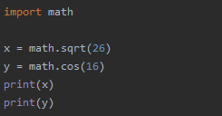


Import Modules
In this lesson we will learn how to import modules that can help us use existing libraries.
So how do we import modules?
Normally when we import a module, we put it at the very top of our codes and we just have to use the import keyword.
After we import the module, to be able to use the functions available of the module we just have to call the module and the function that we need.
There are times that the module we are going to import has a long name, so its advisable to have a shorter name for the module by using the as keyword.
Notice that after we assign a shorter alias for the module, we change how the code looks applying the alias “m”.

Slide 3


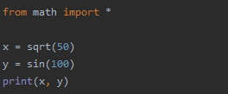

Import Modules
Another way of importing modules is by using the from keyword, this will eliminate the use of the module name before the function.
There are two ways to approach this, first is we import the specific functions needed.
Another way is that we can just import everything using the “*” sign.

Slide 4

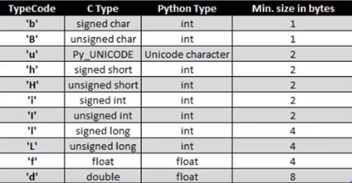
Arrays in Python
In this lesson we will learn about Arrays, in python we have list that serves the purpose of arrays, so why do we need or use arrays in Python?
In terms of execution, it is more faster to process Arrays than list.
In terms of elements inside, Arrays only accepts elements with the same data type
Another advantage of Arrays in Python is that it is mutable, we can add, edit and delete elements.
Now before we can use Arrays, we actually need to import the module arrays.
To use the arrays, we need 2 things; type code and the elements.
We need to identify what type of code we are going to use.

Slide 5





Arrays in Python
In the table, the difference between signed and unsigned is that unsigned will not accept negative values.
For our example lets use the signed int.
Accessing an Array:
Accessing elements of an Array is the same with how we access elements in list.
Adding an element:
To add an element we can use the method append or insert if we need to specify the index.

Slide 6


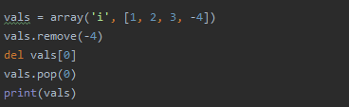

Arrays in Python
Updating an element:
To update an element, we just need to assign the value to an existing index in the list.
Deleting an element:
To delete an element, we can use remove if we want to remove the element itself, then del and pop to remove using an index.

Slide 7
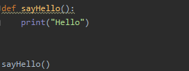
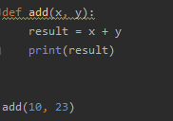

Functions
Functions are use when we need a code that can be reuse multiple times later.
To create a function, we need two things which are defining a function and calling a function.
We use the keyword def and give it a function name.
Its important to have the round bracket “()” for python to identify it is a function.
To call the function we just have to call the name of the function.
Functions can also accept parameters/arguments that can be process inside the function.
As we can see, we pass an arguments and got the result.

Slide 8
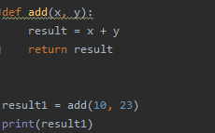
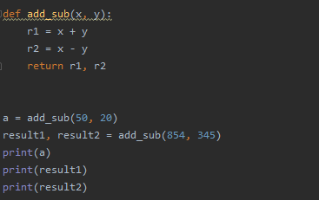

Functions
Functions also can return results by using the keyword return.
To receive the return result of functions, we can assign them to a variable and process it on our own.
We can also return multiple results and assign to a either single variable or multiple variable.
Take note that if we assign it to a single variable, we will be getting a tuple.

Slide 9
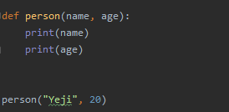

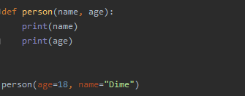

Type of Functions Argument
We have different type of arguments that we can work with. These are:
Position
Keyword
Default
Variable length
In a position argument, we will be following what the position of the argument is requiring.
In this example, since the argument need a string first before an integer, we will pass data accordingly.
in a keyword argument, position is not important as long as we define the keywords of the argument.

Slide 10
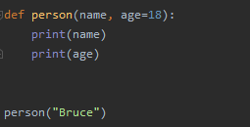

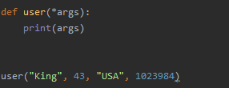

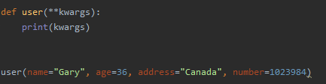
Type of Functions Argument
In a default argument, we will just assign a default value if ever user will not pass a value to a certain argument
Last is Variable length arguments, we have two variable length arguments available in python.
First is single asterisk “*”. This will make an argument to accept multiple data. By convention we use the keyword ”args”. The data will be group to a tuple
Second is the double asterisk ”**”. The difference of this is we can also pass keywords. By convention we use the keyword “kwargs”. The data will be group to a dictionary.

Slide 11





Anonymous Functions
Anonymous functions are functions without name and it is also called as Lambda:
Anonymous functions are usually 1 liner codes that has a single expressions.
For example we have a function squared that has a single expression.
We notice that it’s a waste of line when we will be having a function that will have a single expression.
So if we want to use a function only once, and we don’t want to define a function, and if we only have one expression, we can use lambda.
We can also have multiple arguments as long as it only have one expression.

Slide 12


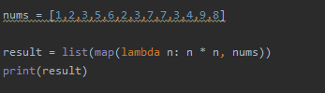

Filter, Map, and Reduce
Previously we learned about lambda, to further explain lambda on why we use it in our codes, we will be using it inside methods filter, map, and reduce.
Filter will take a sequential data and filter those list based on conditions set and return the value.
Filter method will have 2 arguments, a function and a sequence. Instead of creating a functions, we just used the anonymous function lambda.
So what about Map? We use Map if we want to change or process every value in a sequential data.

Slide 13

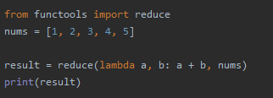

Filter, Map, and Reduce
Finally is Reduce. We use Reduce when we want to reduce a data into a single value.
Before we can use Reduce, we need to import functools.
Example of Reduce with lambda function.
Reduce always takes 2 arguments.

Slide 14






Comprehension
Comprehension is an easier and more readable way of creating List, Dictionary, or sets in Python.
It is a 1 liner code that fetch or process elements within a list, dictionary or sets.
List Comprehension:
Another example is when we do something with the data we get.
Another example of list comprehension with a conditional statement.

Slide 15



Comprehension
Comprehension can also perform a nested loop and return pair values.
Take note that we need to use the same variable name that we use in the loop.
Dictionary Comprehension
We can also make a dictionary out of 2 list by using the method zip.
The zip method matches the index of both list into a tuple within a list.

Slide 16


Comprehension
Sets Comprehension
Take note that sets will give us unique values.

Slide 17
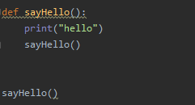




Recursion
Recursion in generally means you are calling a function from itself.
Supposedly this will give as an infinite loop since it’s calling itself non stop, but to avoid our program hanging from infinite loop, by default python set a limit to a recursion which is 1000 times.
to check this we can call the getrecursionlimit method in sys.
If we want to change this, we can simply call the setrecursionlimit and give it a value.

Slide 18
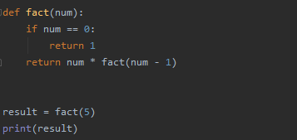

Recursion
Factorial in a Recursion:
To explain more how recursion works, lets create a factorial method.

Slide 19
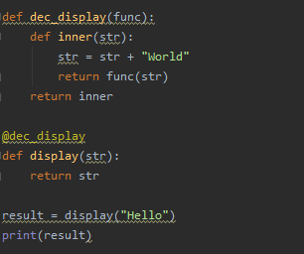

Decorators
Decorators are functions that takes a functions a an argument and return another function.
We also use decorators to change the behavior of an existing function.
In the dec_display function, it will accept another function and change the str value and call the display function with the updated str value.
For this to work, they should have a some form of connection, this connection is the @dec_display where it will identify that we are using a decorator to the display function.

